Slide 1
Mathematics Materials Lecturer A.M.Alazzawe FIRST CLASS
SEMESTER ONE
CHAPTER 2
1.3 Functions and Their Graphs
❖ Functions are the major objects we deal with in calculus because they are key to describing
the real world in mathematical terms.
❖ This section reviews the ideas of functions, their graphs, and ways of representing them.
❖ Functions; Domain and Range
✓ The area of a circle depends on the radius of the circle.
✓ The distance an object travels from an initial location along a straight line path depends on
its speed.
❖ In each case, the value of one variable quantity, which we might call y, depends on the
value of another variable quantity, which we might call x. Since the value of y is completely
determined by the value of x, we say that y is a function of x.
❖ In this notation, the symbol ƒ represents the function. The letter x, called the independent
variable, represents the input value of ƒ, and y, the dependent variable, represents the
corresponding output value of ƒ at x.
➢ The set D of all possible input values is called the domain of the function.
➢ The set of all values of ƒ(x) as x varies throughout D is called the range of the function.
➢ The range may not include every element in the set Y.
1

Slide 2
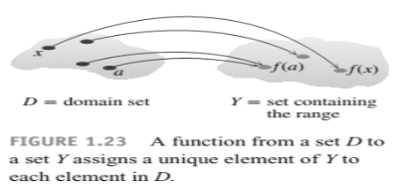
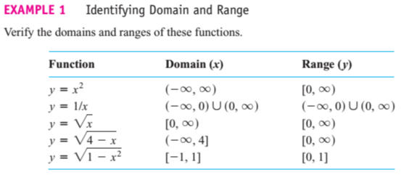
Mathematics Materials Lecturer A.M.Alazzawe FIRST CLASS
SEMESTER ONE
2

Slide 3
Mathematics Materials Lecturer A.M.Alazzawe FIRST CLASS
SEMESTER ONE
Graphs of Functions
❖ If ƒ is a function with domain D, its graph consists of the points in the Cartesian plane
whose coordinates are the input-output pairs for ƒ.
2
Example: Use point plotting to sketch the graph of ( y = x )Discuss the limitations of this method.
Example: Sketch the graph of( y = √x ) .
Solution
If (x<0), then (√x) is an imaginary number. Thus, we can only plot points for which (x ≥ 0), since
points in the xy-plane have real coordinates. The graph obtained by point plotting.
2
Example Sketch the graph of (y −2y − x =0).
Solution
In this case it is easier to express in terms of y, so we rewrite the equation as (x =y −2y) Members
of the solution set can be obtained from this equation by substituting arbitrary values for y in the
right side and computing the associated values of x.
2
3

Slide 4
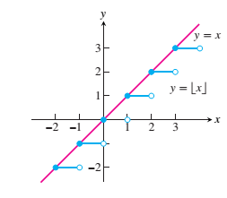
Mathematics Materials Lecturer A.M.Alazzawe FIRST CLASS
SEMESTER ONE
Example Sketch the graph of y=1/x.
Solution
Because (1/x) is undefined at x=0, we can only plot points for which x ≠ 0. This forces a break,
called a discontinuity, in the graph at (x = 0).
Greatest integer function is a piece-wise defined function.
❖ The function, or rule which produces the "greatest integer less than or equal to the number"
operated upon, symbol [x] or sometimes [[x]].
❖ The greatest integer function is a piece-wise defined function.
❖ If the number is an integer, use that integer.
❖ If the number is not an integer, use the next smaller integer.
Examples:
number
|
the greatest integer less than or equal to the number
x
4
4.4
-2
-2.3
|
[x]
|
[4] = 4
|
[4.4] = 4
|
|
[-2] = -2
[-2.3] = -3
4

Slide 5
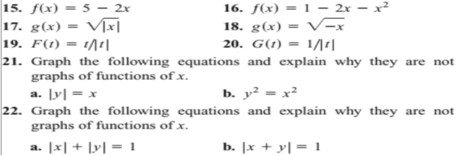
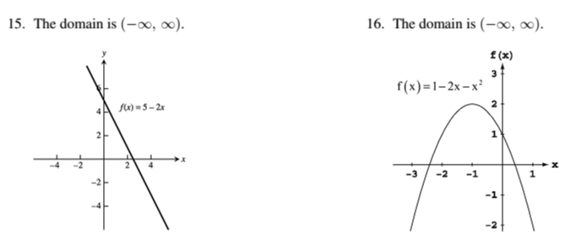
Mathematics Materials Lecturer A.M.Alazzawe FIRST CLASS
SEMESTER ONE
Solved questions
Find the domain and range of each function.
Solution
❖ Find the domain and graph the functions in Exercises 15–20
❖ Solution
We have first draw the function and then determine the domain
5

Slide 6
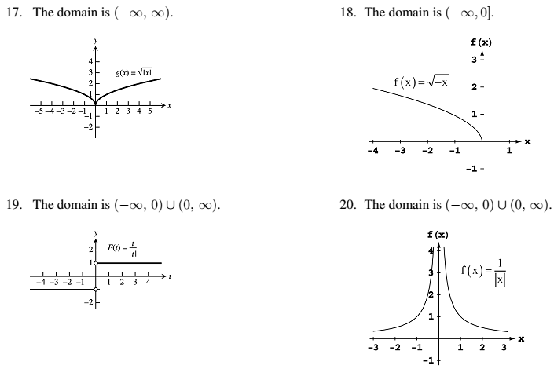
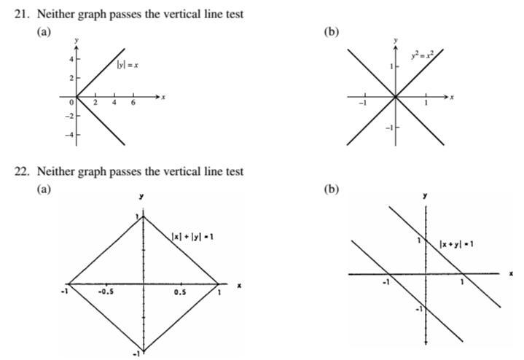
Mathematics Materials Lecturer A.M.Alazzawe FIRST CLASS
SEMESTER ONE
6

Slide 7
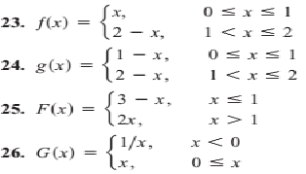
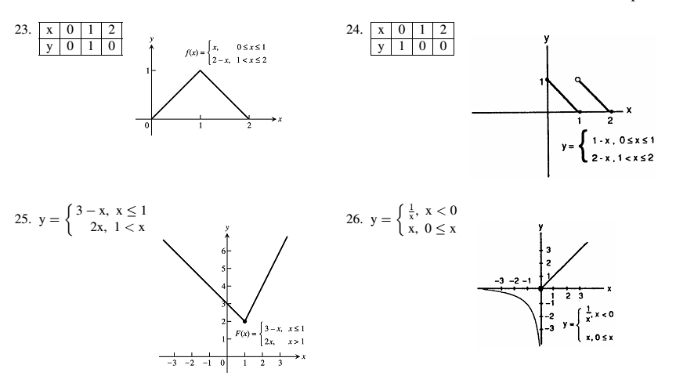
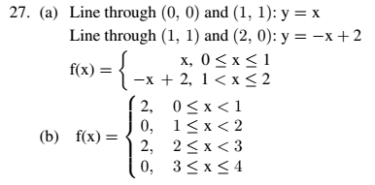
Mathematics Materials Lecturer A.M.Alazzawe FIRST CLASS
SEMESTER ONE
❖ Greatest integer function Piecewise-Defined Functions
Graph the functions in Exercises 23–26
Solution
27. Find a formula for each function graphed
Solution
7

Slide 8
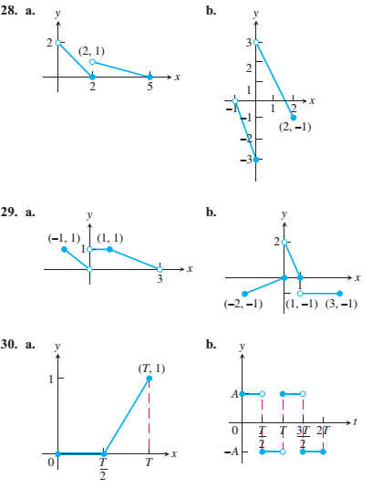
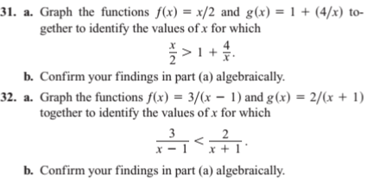
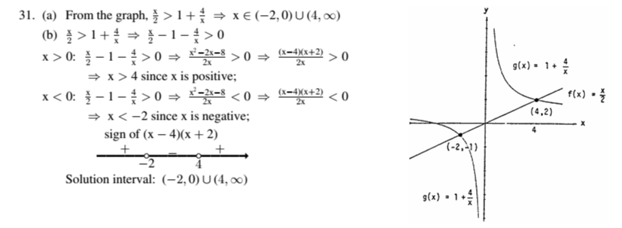
Mathematics Materials Lecturer A.M.Alazzawe FIRST CLASS
SEMESTER ONE
❖ Solution
8

Slide 9
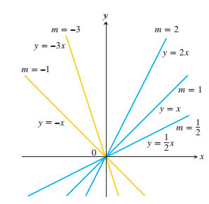
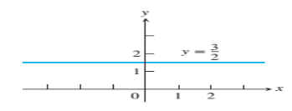
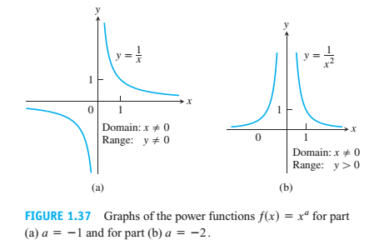
Mathematics Materials Lecturer A.M.Alazzawe FIRST CLASS
SEMESTER ONE
1.4 Identifying Functions; Mathematical Models
❖ There are a number of important types of functions frequently encountered in calculus. We
identify and briefly summarize them here.
❖ Linear Functions: A function of the form for constants( m and b), is called a linear
function. Figure below shows an array of lines where so these lines pass through the
origin. Constant functions result when the slope m=0 .
a
❖ Power Functions: A function (f(x) = x ) where a is a constant, is called a power function.
There are several important cases to consider.
(a) a = n ,,, a positive integer
n
The graphs of (f(x) = x ) for n= 1, 2, 3, 4, 5,
9

Slide 10
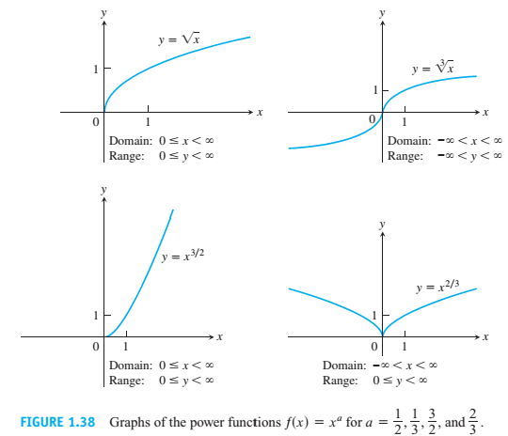
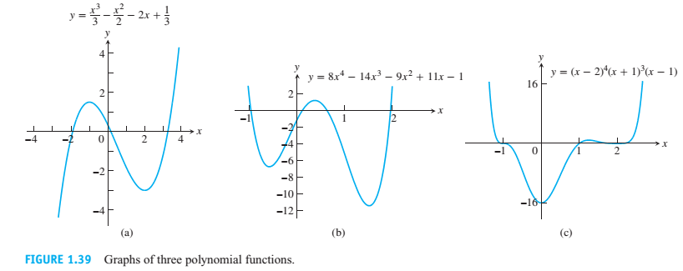
Mathematics Materials Lecturer A.M.Alazzawe FIRST CLASS
SEMESTER ONE
❖ Polynomials: A function p is a polynomial if
where (n) is a nonnegative integer and the numbers (a0,a1,a2, ,……an ) are real constants (called
the coefficients of the polynomial). All polynomials have domain (- ∞, ∞) . If the leading
coefficient (an ≠ 0) and (n > 0) then n is called the degree of the polynomial. Linear functions with
(m ≠ 0) are polynomials of degree 1. Polynomials of degree 2, usually written as
are called quadratic functions. Likewise, cubic functions are polynomials
of degree 3. Figure below shows the graphs of three polynomials.
10

Slide 11
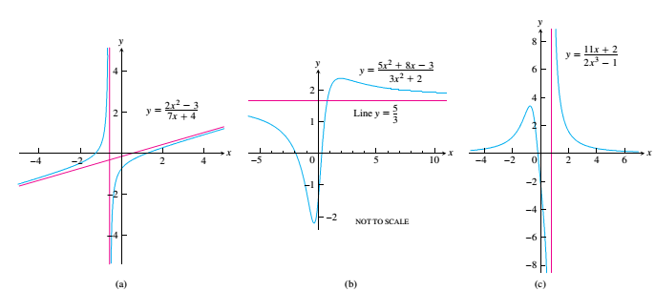
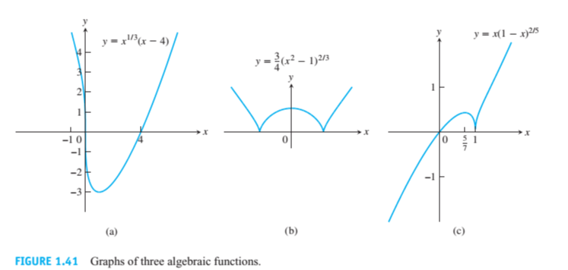
Mathematics Materials Lecturer A.M.Alazzawe FIRST CLASS
SEMESTER ONE
❖ Rational Functions: A rational function is a ratio of two polynomials:
where p and q are polynomials. The domain of a rational function is the set of all real x for
which ( q(x) ≠ 0 ) For example,
the function is a rational function with domain
Its graph is shown below
❖ Algebraic Functions: An algebraic functionis a function constructed from polynomials
using algebraic operations (addition, subtraction, multiplication, division, and taking roots).
❖ Exponential Functions: Functions of the form (f(x) = a ) where(a>0) the base is a positive
constant (a ≠ 1) and are called exponential functions. All exponential functions have
domain (-∞ , ∞)and range (0. ∞) So an exponential function never assumes the value 0.
x
11

Slide 12
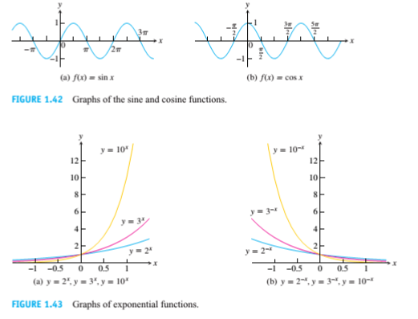
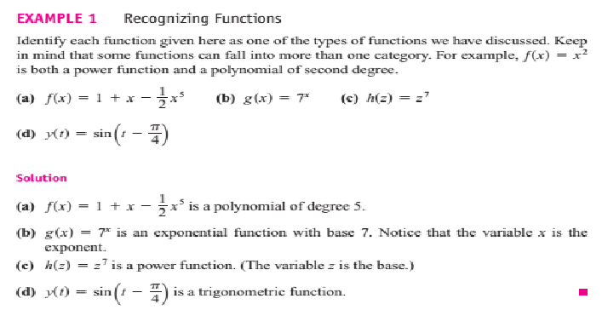
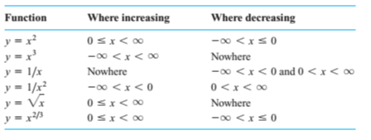
Mathematics Materials Lecturer A.M.Alazzawe FIRST CLASS
SEMESTER ONE
Increasing Versus Decreasing Functions:
Even Functions and Odd Functions: Symmetry
12

Slide 13
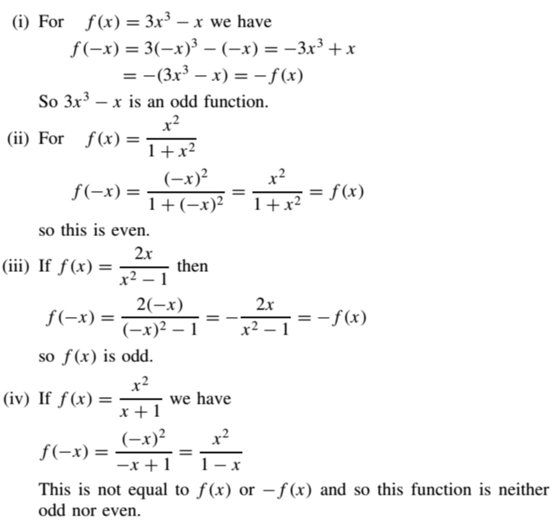
Mathematics Materials Lecturer A.M.Alazzawe FIRST CLASS
SEMESTER ONE
❖ The graph of an even function is symmetric about the y-axis. Since f(-x) = f(x)a point (x,
y) lies on the graph if and only if the point ( x,y) lies on the graph (Figure a). A reflection
across the y-axis leaves the graph unchanged.
13

Slide 14
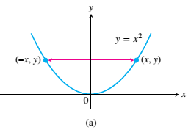
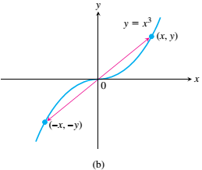
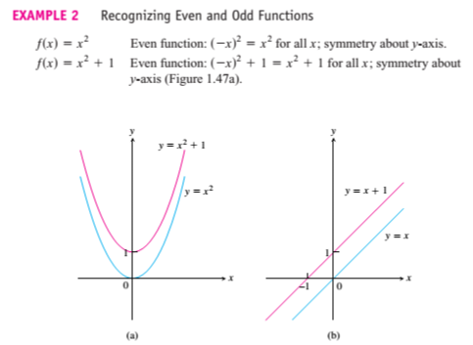
Mathematics Materials Lecturer A.M.Alazzawe FIRST CLASS
SEMESTER ONE
❖ The graph of an odd function is symmetric about the origin. Since f(-x) = -f(x) a point (x,
y) lies on the graph if and only if the point(-x, -y) lies on the graph (Figure b). Equivalently,
a graph is symmetric about the origin if a rotation of 180° about the origin leaves the graph
unchanged. Notice that the definitions imply both x and must be in the domain of ƒ.
FIGURE 1.47
14

Slide 15
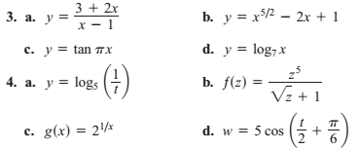
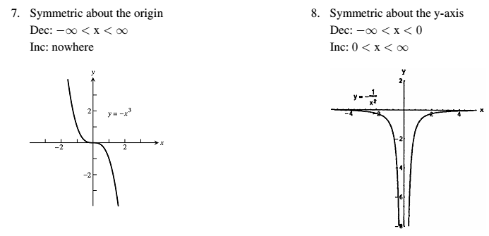
Mathematics Materials Lecturer A.M.Alazzawe FIRST CLASS
SEMESTER ONE
❖ Solved question
In Exercises 1–4, identify each function as a constant function, linear function, power
function, polynomial (state its degree), rational function, algebraic function, trigonometric
function, exponential function, or logarithmic function. Remember that some functions can
fall into more than one category.
❖ Solved questions
Increasing and Decreasing Functions
Graph the functions in Exercises 7–18. What symmetries, if any, do the graphs have? Specify the
intervals over which the function is increasing and the intervals where it is decreasing.
Dec is decrease
Inc is increase
15

Slide 16
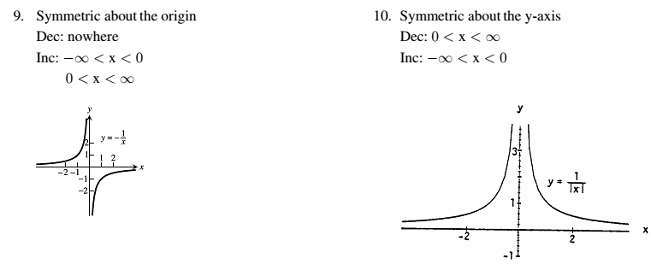
Mathematics Materials Lecturer A.M.Alazzawe FIRST CLASS
SEMESTER ONE
❖ Solved question
Even and Odd Functions
In Exercises 19–30, say whether the function is even, odd, or neither. Give reasons for your
answer
16

Slide 17
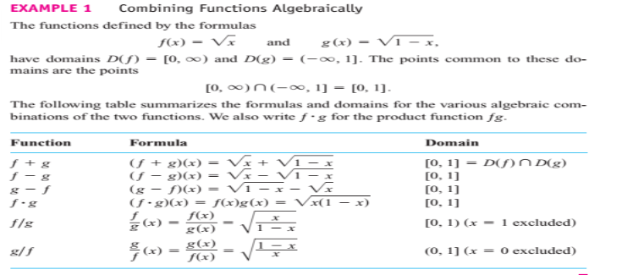
Mathematics Materials Lecturer A.M.Alazzawe FIRST CLASS
SEMESTER ONE
1.5 Combining Functions; Shifting and Scaling Graphs
In this section we look at the main ways functions are combined or transformed to form new
functions.
Sums, Differences, Products, and Quotients
Like numbers, functions can be added, subtracted, multiplied, and divided (except where the
denominator is zero) to produce new functions. If ƒ and g are functions, then for every x that
belongs to the domains of both ƒ and g
functions and ƒg by the formulas
(that is, for ), we define
17

Slide 18
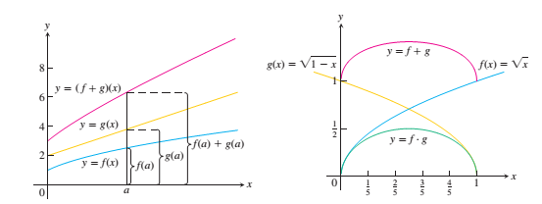
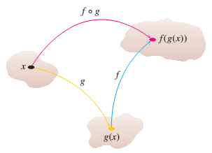
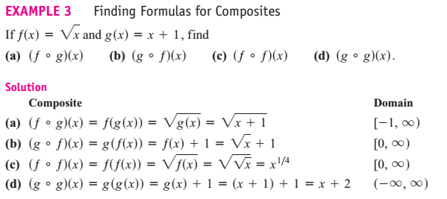
Mathematics Materials Lecturer A.M.Alazzawe FIRST CLASS
SEMESTER ONE
❖ Composite Functions
❖ Composition is another method for combining functions.
❖ The definition says that (f0g) can be formed when the range of (g) lies in the domain of ƒ.
To find ((f0g)(x)) first find g(x) and second find ƒ(g(x)).
18

Slide 19
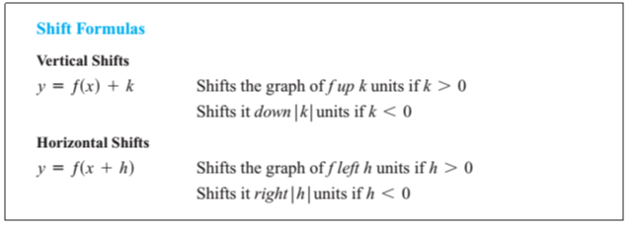
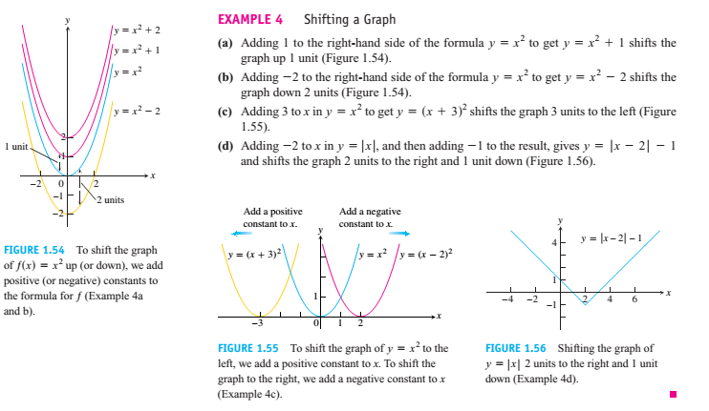
Mathematics Materials Lecturer A.M.Alazzawe FIRST CLASS
SEMESTER ONE
❖ Shifting a Graph of a Function
❖ To shift the graph of a function (y= f(x)) straight up, add a positive constant to the right
hand side of the formula (y= f(x)).
❖ To shift the graph of a function (y= f(x)) straight down, add a negative constant to the right-
hand side of the formula (y= f(x)).
❖ To shift the graph of (y= f(x)) to the left, add a positive constant to x.
❖ To shift the graph of (y= f(x)) to the right, add a negative constant to x.
❖ Solved question
19

Slide 20
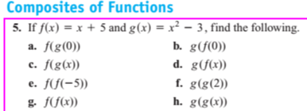
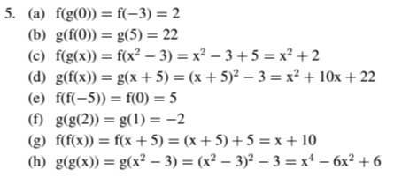
Mathematics Materials Lecturer A.M.Alazzawe FIRST CLASS
SEMESTER ONE
solution
20

Slide 21
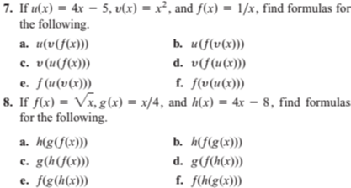
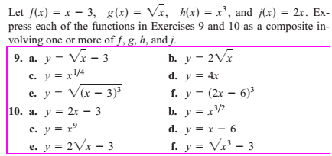
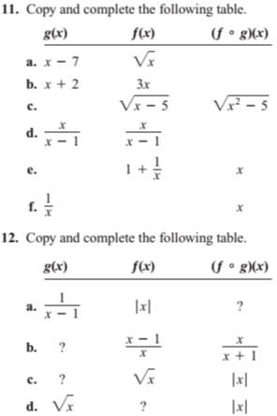
Mathematics Materials Lecturer A.M.Alazzawe FIRST CLASS
SEMESTER ONE
solution
21

Slide 22
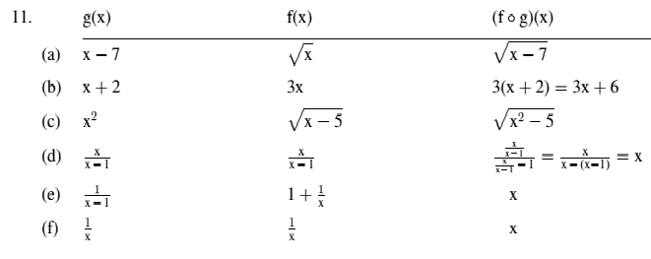
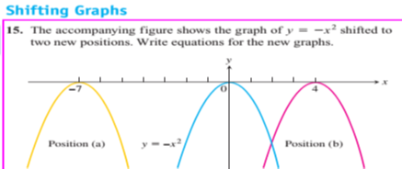
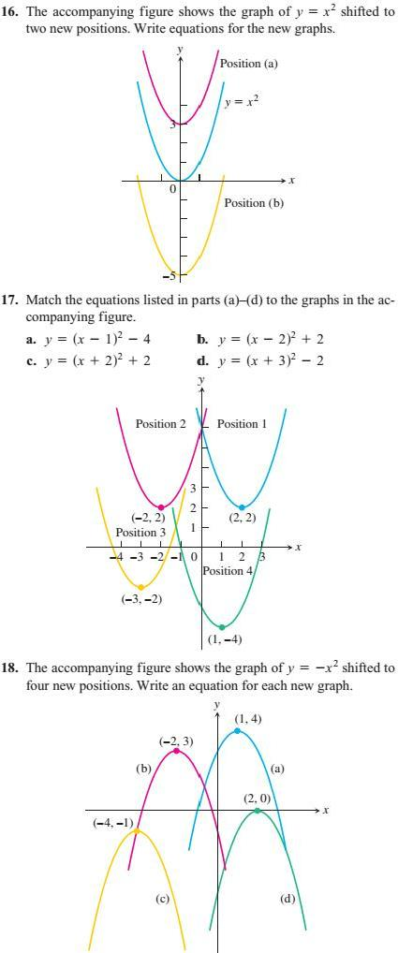
Mathematics Materials Lecturer A.M.Alazzawe FIRST CLASS
SEMESTER ONE
solution
22

Slide 23
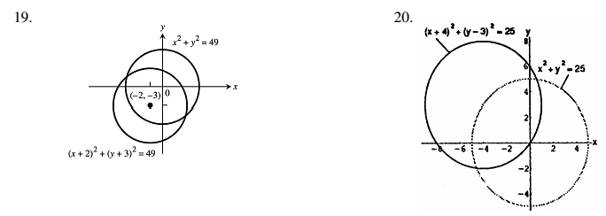
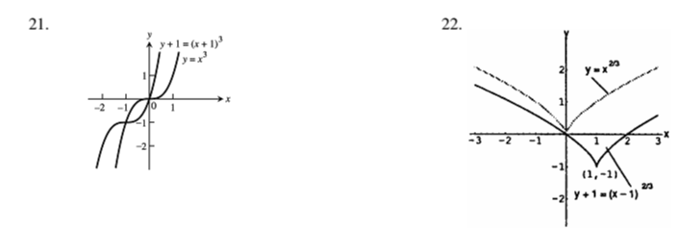
Mathematics Materials Lecturer A.M.Alazzawe FIRST CLASS
SEMESTER ONE
❖ Exercises
given
equations are to be shifted. Give an equation for the shifted graph. Then sketch the original
and shifted graphs together, labeling each graph with its equation.
19
–28 tell
how many units
and
in
what
directions
the
graphs
of
the
solution
solution
23

Slide 24
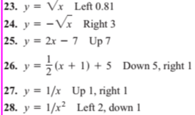
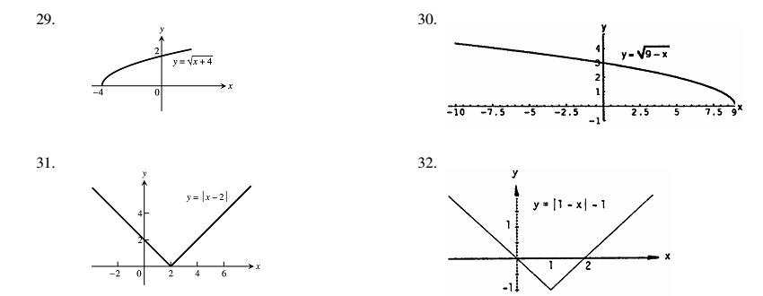
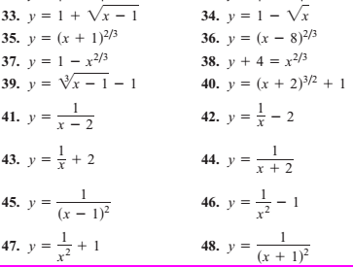
Mathematics Materials Lecturer A.M.Alazzawe FIRST CLASS
SEMESTER ONE
solution
24

